Slide 1
Wi-CHAT Project Presentation
Instructor
MD. Motiur Rahman
Associate Professor,
CSE, MBSTU

Slide 2
Team Members:
Mirza Inkiad Ahmed Prangon (ID – CE 13015)
Mahfuzur Rahman (ID – CE 13013)
Shahriar Shabbir Tarafdar (ID – CE 13017)
MD. Muntasir Hossain (ID – CE 13014)
Mahmood Shahriar (ID – CE 13016)
Department of CSE, MBSTU
Project Instructor:
MD. Motiur Rahman
Associate Professor
Dept. of CSE, MBSTU

Slide 3
Project Details – Name is Wi-Chat!!!
This project is a simple chat client which can send and receive text message between two locally connected computers. Wi-Chat works on both wired and wireless networks.
Wi-Chat can send messages to any type of local network, the computers can be connected by switch, router, even wireless router or Wi-Fi router.

Slide 4


Applications and tools used in Wi-Chat
We wanted to familiarize ourselves with professional tool while working in this project. For that we used –
1. 2012
2. .NET features
3. Language: C++, C#
4. Windows MFC library
5. Microsoft visual studio compiler

Slide 5
About the project and networking
Networking and telecommunication is the main source of information and communication for mankind now a day. We make business proposal while being abroad, we can communicate with a man who is continents away with a click of a button. Or talk with our near and dear ones from anywhere. Life has become indeed easier. We are living in a vast ocean of digital signals, trillions of trillions of bits floating around us, searching their destination.
This project is a simple project in the field of networking and telecommunication. With this application two users can communicate with each other by text message through LAN.

Slide 6
The Goal of the Project
The goal of this project was not to build a robust application for communication. It is a simple text chat client which works on Local Area Network. But the goal of this project was to familiarize us, the students with the way networking works, infrastructure of the network itself, how to write an application to communicate through network, how to implement network programming procedure to achieve a working solution.
Thus this is our small journey to finish a project, stumble two or three times in the way while learning many things in the process. We ought to tell, it was fun to do.

Slide 7
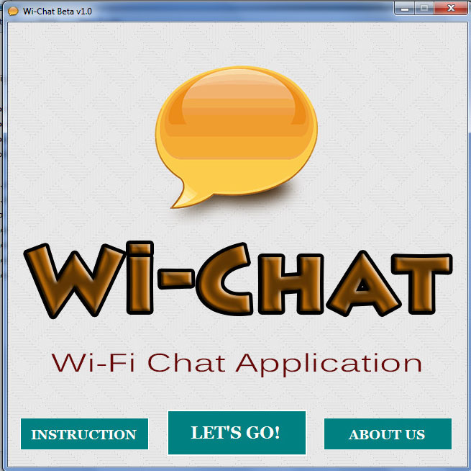
How to use Wi-Chat
First open Wi-Chat.
You will see the
welcome screen.
Click on
“LET’S GO” button

Slide 8
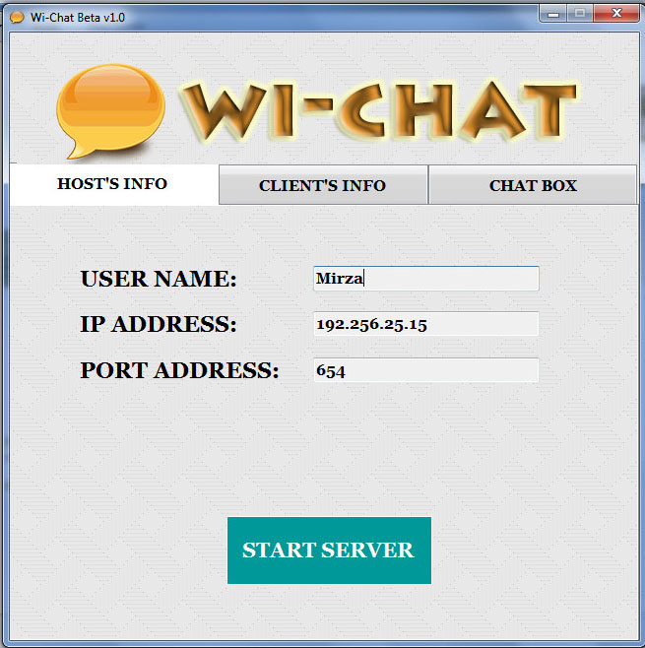
Now input your name and port you want in the Host’s info tab. You can insert any name you want. But input port number greater than 100 to be safe. IP Address will be automatically filled with your own IP address.

Slide 9
Click on the Start Server button
Your partner will also have to follow these steps in his/her computer. You two have to note your own IP Address and Port address in Host’s info tab.

Slide 10
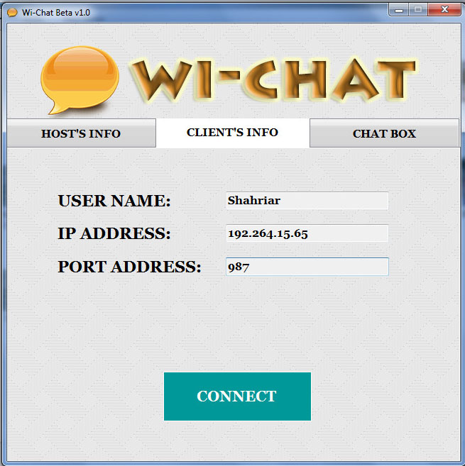
Go to clients info tab.
You have to put your partners name, IP and port. Your partner have to put your IP and port here.
Then click CONNECT button

Slide 11
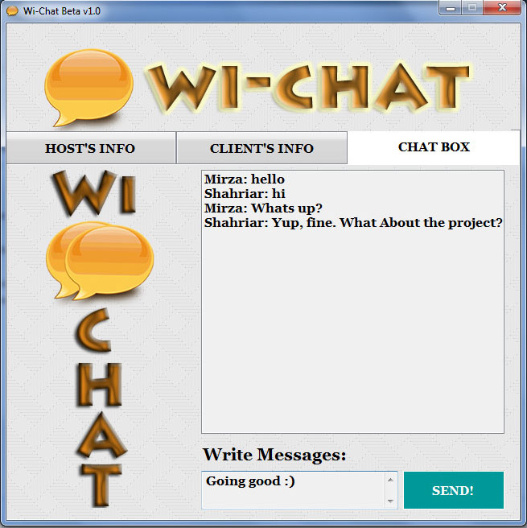
Go to Chat Box tab to start chatting!!!
Enter your message here

Slide 12
The chat window shows message from your partner and your own sent messages.
Then click the send button to send the message

Slide 13
Some technical details about Wi-Chat
We used IP version 4.
Port number can be any valid port number. But it is recommended not to use special ports such as 80, 22.
We used Unicode encoding to send and receive text.
This application has not been tested thoroughly by end user. So, some bugs may exist.

Slide 14
Prerequisites to run Wi-Chat
.NET framework 4 redistributable must be installed to run the application.
The application is developed for windows platform only. Application is tested in windows 7 and 8. Older version of windows may not run the application properly.

Slide 15
Further Research and Upcoming Plans
This application now can only send and receive texts. We want to add features like sharing pictures, audio and different types of files within the application.
Adding multiple user chat support.

Slide 16
Further Research and Upcoming Plans(cont.)
We want to add voice chat beside text based messaging.
Future plan is to add support for internet so that any one connected to the internet can use this application.

Slide 17
Thank You

